Slide 1
Lisa Shoop
Agile Coaching Sabre
How to Sustain Agile - Teams and Organizations

Slide 2


Case Study: Agile Teams Sabre
Overview
Three major product lines – Planning, Operations and Reservations
1400+ technology team members in three primary locations (50% growth YOY for three years)
Wide diversity of technology driving need for a variety of specialized technical skills across locations
Journey

Slide 3
Airline Solutions Agile Fast Facts
Practicing Agile for eight years
Teams reached maturity state in practicing Agile principles using different methods
Team members periodically attended training, conferences
Kept internal coaching staff of 3-4 coaches across locations
Then……
Noticed slippage in teams practicing Agile

Slide 4

All the right “pieces”
- “The Design of Everyday things” by Donald Norman
Notes:
23

Slide 5

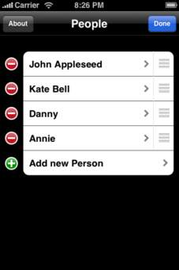

My Agile Team Experienced Success – how & what changed?
Resources move & it changes the “team”
5

Slide 6

What now?
6

Slide 7


Slide 8
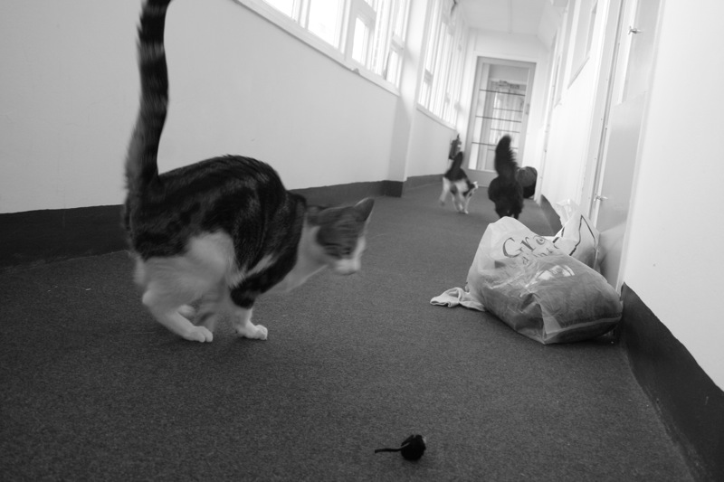
Herding the Converted
Three key decisions
Executive sponsorship
Baseline
Iterative rollout with early success
Lay foundation for establishing a common Agile development culture
8
Notes:
13

Slide 9

Software process mandates usually fail
Process change has to accurately address the needs of those performing the work
Need change leadership
Focus on development culture
Give time for team to socialize change
Focus on immediate problems; seek early success
Want buy-in; not compliance
Winning over the skeptics
Winning over the skeptics
Wanted: Buy In, not compliance
9
Notes:
18

Slide 10
Strategy: Transform Sabre’s Ad-Hoc Agile to efficient Scrum Teams
Build communities to drive grass-roots support
Instill Agile values and Scrum Enterprise
Training Teams & Mentor Scrum Masters

Slide 11
Agile Simplicity
Scrum is An Elegantly Simple Software Method
Three Roles
Product Owner
Scrum Master
Development teams
The Ceremonies
Daily Scrum (Stand-Up)
Sprint/Iteration Planning
Sprint Review
Sprint Retrospective
Three Artifacts
Product Backlog
Sprint Backlog
Increments
11

Slide 12
Why Scrum at Sabre?
Organization
Provides transparency
Provides predictable delivery
Customer
Quicker access to features
Team
Builds upon XP practices
Fosters a sustainable pace
Increases teamwork
12
Notes:
Team - to support Business & IT
Pace - that is efficient, consistent and rewarding
Org – In planning prioritization for delivery of high business value solutions and increases teamwork across dev, deliv and markting
Customer - enhanced estimation practices, commitments to promote predictable and features faster

Slide 13
How We Get There
Transformation & Continuous Learning
eLearning
broad reach
Communications
SM/PO Training
Quick Hit Videos
Community
Workshops
deep impact
Needs Assessments/ Engagement Model
Team Launch
Cadence Coaching
Measure Results Ongoing Assessment
13

Slide 14

KEY TAKE AWAYS
Recognize that change in a team impacts - big or small
Plan! For learning and training
Use multiple ways of training and keep Agile fresh
- team needs will be different
14

Slide 15

15

Slide 16
Lisa Shoop
Lisa.Shoop@sabre.com
Twitter @LASHOOP

